Slide 1

Operating Systems and Linux Programming - M23DE0105
MCA Sem I - Academic Year : 2024- 2025 ODD Semester

Slide 2
Lecture - 1

Slide 3
AGENDA
Introduction
Course Objective
Course Outcomes
Quick look at Syllabus
Text Book
Continuous Assessment

Slide 4

Introduction – Operating System
a collection of programs which control the resources of a computer system
written in low-level languages (i.e. machine-dependent)
an interface between the users and the hardware
when the computer is on, the OS will first load into the main memory
02

Slide 5
Course Objective
Define the fundamentals of Operating Systems.
Illustrate distributed resource management components viz. the algorithms for implementing distributed shared memory, recovery, and commit protocols.
Expose the design of the LINUX operating system.
Demonstrate the different types of filters used in LINUX.
03

Slide 6
Course Outcomes
CO1 - Identify the basic principles adopted in the design of modern operating systems.
CO2 - Explain the objectives and functions of modern opera ting systems.
CO3 - Describe how computing resources are used by application software and managed by system software.
CO4 - Analyze, Design, and Interpret the concepts of shell programming.
04

Slide 7
Quick Look at the Syllabus
Unit 1:Introduction - Process Management
Unit 2:Dead locks
Unit 3:Introduction with shell and Desktop to Linux
Unit 4:Basic Linux Administration
05

Slide 8
Quick Look at the Syllabus
Unit 1:Introduction - Process Management
Introduction: Batch Systems, Multiprogramming and Time Sharing, Parallel, Distributed and Real-time Systems, Operating System Structures, Components & Services, System calls.
Process Management: Process Concept, Process Scheduling, Threads, Inter- process communication, CPU Scheduling Criteria, Scheduling algorithm, Multiple Processor Scheduling,. The Critical Section Problem, Synchronization hardware, Semaphores, and Classical problems of synchronization.
06

Slide 9
Quick Look at the Syllabus
Unit 2: Dead locks
Deadlocks: system model, Characterization, Deadlock prevention, avoidance and detection, Recovery from deadlock.
Memory Management: Logical and Physical address space, Swapping, Contiguous allocation, Paging, Segmentation, Segmentation with paging, Virtual memory -Demand paging and its performance, Page replacement algorithms, Allocation of frames, Thrashing.
07

Slide 10
Quick Look at the Syllabus
Unit 3: Introduction with shell and Desktop to Linux
Introduction and interacting with shell and Desktop to Linux: History, salient features, Linux system architecture, Linux command format, Linux internal and external commands, Directory commands, File related commands, Disk related commands.
The Linux Shell Basic commands cls, cat, cal, date, calendar, who, printf, tty, sty, uname, passwd, echo, tput, bc, script, Introduction to Shell Scripting, read, Command Line Arguments, Exit Status of a Command.
shell types, shell script features, executing a shell script, system and user-defined variables, expr command, command substitution, escape sequence characters, shell script arguments, positional parameters, test command, file test, string test, numeric test
08

Slide 11
Quick Look at the Syllabus
Unit 4: Basic Linux Administration
Conditional Control Structures-if statement, case statement, Looping Control Structure-while, until, for, statements.
Filters, Stream editor SED and AWK, Linux System Communication: Introduction, write, read, wall commands, sending and handling mails. System Administration: Roles of a System Administrator.
09

Slide 12
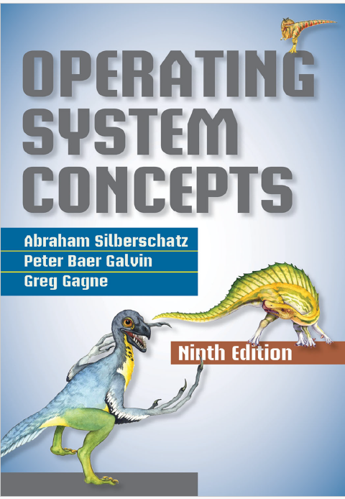
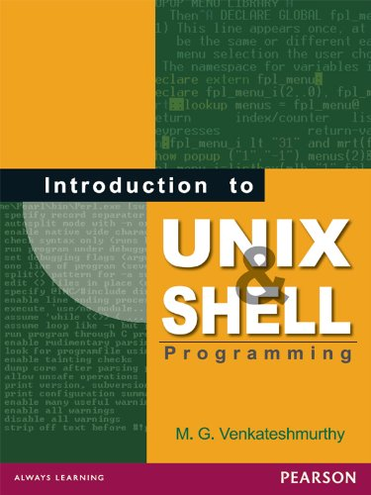
Text Book
10

Slide 13
Continuous Assessment
Sl. No | Assessment Component |  | Marks | Conduction Date | Results Date
1 | IA1 | Test Assignment Seminar | 30 (15) 5 5
2 | IA2 | Test Assignment Seminar | 30 (15) 5 5
3 | SEE |  | 100 (50)
02

Slide 14
Summary
Introduction
Course Objective
Course Outcomes
Quick look at Syllabus
Text Book
Continuous Assessment

Slide 15
Lecture - 2

Slide 16
Recap
Introduction
Course Objective
Course Outcomes
Quick look at Syllabus
Text Book
Continuous Assessment

Slide 17
Agenda
Introduction to Operating System

Slide 18
Introduction to OS
What is an Operating System?
A program that acts as an intermediary between a user of a computer and the computer hardware.
Operating system goals:
Execute user programs and make solving user problems easier
Make the computer system convenient to use
Use the computer hardware in an efficient manner
02

Slide 19
Introduction to OS
Computer System Structure
Computer system can be divided into four components:
Hardware – provides basic computing resources
CPU, memory, I/O devices
Operating system
Controls and coordinates use of hardware among various applications and users
Application programs – define the ways in which the system resources are used to solve the computing problems of the users
Word processors, compilers, web browsers, database systems, video games
Users
People, machines, other computers
02

Slide 20
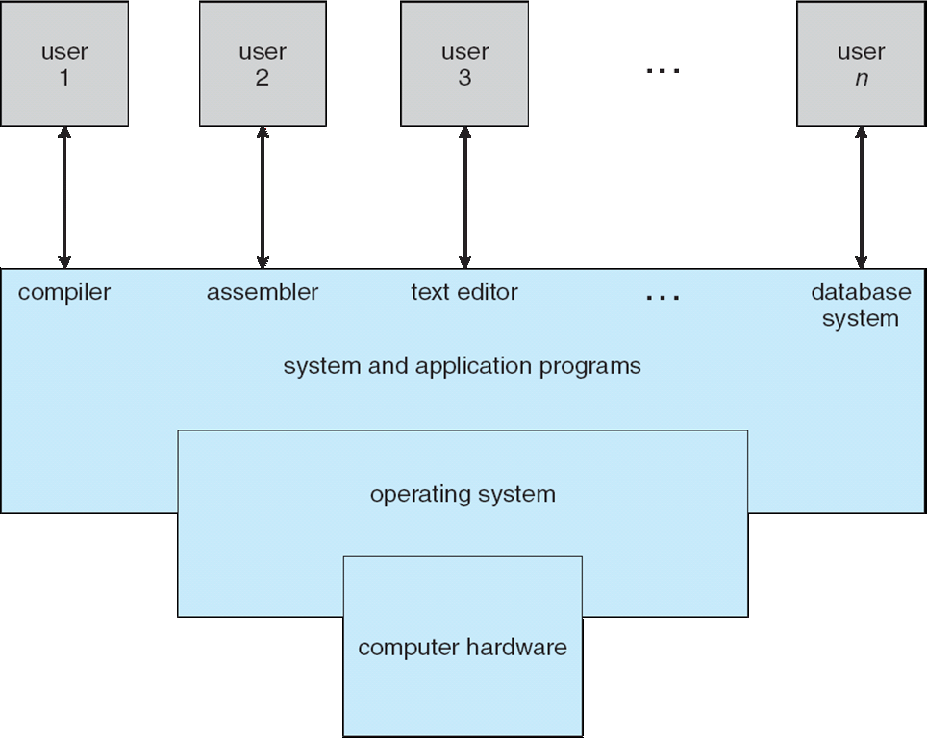
Introduction to OS
Four Components of a Computer System
02

Slide 21
Introduction to OS
What Operating Systems Do ?
Depends on the point of view
Users want convenience, ease of use and good performance
Don’t care about resource utilization
But shared computer such as mainframe or minicomputer must keep all users happy
Users of dedicate systems such as workstations have dedicated resources but frequently use shared resources from servers
Handheld computers are resource poor, optimized for usability and battery life
Some computers have little or no user interface, such as embedded computers in devices and automobiles
02

Slide 22
Introduction to OS
Operating System Definition
OS is a resource allocator
Manages all resources
Decides between conflicting requests for efficient and fair resource use
OS is a control program
Controls execution of programs to prevent errors and improper use of the computer
02

Slide 23
Introduction to OS
Operating System Definition
No universally accepted definition
“Everything a vendor ships when you order an operating system” is a good approximation
But varies wildly
“The one program running at all times on the computer” is the kernel.
Everything else is either
a system program (ships with the operating system) , or
an application program.
02

Slide 24
Introduction to OS
Computer Startup
bootstrap program is loaded at power-up or reboot
Typically stored in ROM or EPROM, generally known as firmware
Initializes all aspects of system
Loads operating system kernel and starts execution
02

Slide 25
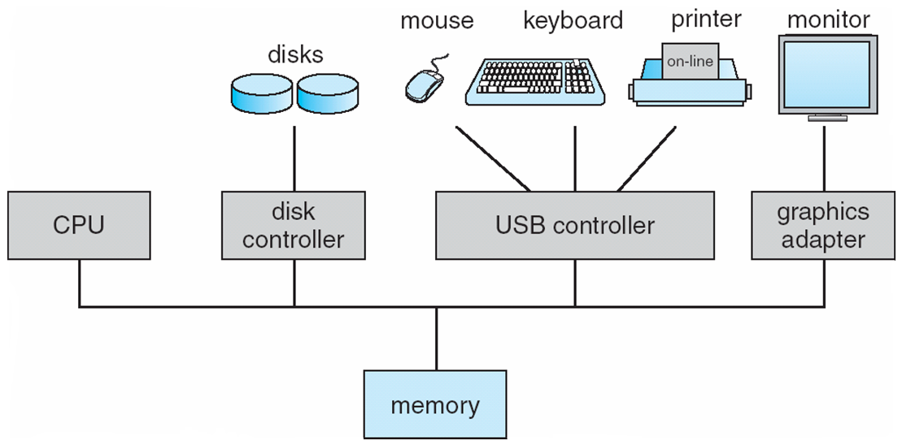
Introduction to OS
Computer System Organization
Computer-system operation
One or more CPUs, device controllers connect through common bus providing access to shared memory
Concurrent execution of CPUs and devices competing for memory cycles
02

Slide 26
Introduction to OS
Computer-System Operation
I/O devices and the CPU can execute concurrently
Each device controller is in charge of a particular device type
Each device controller has a local buffer
CPU moves data from/to main memory to/from local buffers
I/O is from the device to local buffer of controller
Device controller informs CPU that it has finished its operation by causing an interrupt
02

Slide 27
Introduction to OS
Common Functions of Interrupts
Interrupt transfers control to the interrupt service routine generally, through the interrupt vector, which contains the addresses of all the service routines
Interrupt architecture must save the address of the interrupted instruction
A trap or exception is a software-generated interrupt caused either by an error or a user request
An operating system is interrupt driven
02

Slide 28
Introduction to OS
I/O Structure
After I/O starts, control returns to user program only upon I/O completion
Wait instruction idles the CPU until the next interrupt
Wait loop (contention for memory access)
At most one I/O request is outstanding at a time, no simultaneous I/O processing
After I/O starts, control returns to user program without waiting for I/O completion
System call – request to the OS to allow user to wait for I/O completion
Device-status table contains entry for each I/O device indicating its type, address, and state
OS indexes into I/O device table to determine device status and to modify table entry to include interrupt
02

Slide 29
Introduction to OS
Storage Structure
Main memory – only large storage media that the CPU can access directly
Random access
Typically volatile
Secondary storage – extension of main memory that provides large nonvolatile storage capacity
Hard disks – rigid metal or glass platters covered with magnetic recording material
Disk surface is logically divided into tracks, which are subdivided into sectors
The disk controller determines the logical interaction between the device and the computer
Solid-state disks – faster than hard disks, nonvolatile
Various technologies
Becoming more popular
02

Slide 30
Introduction to OS
Storage Hierarchy
Storage systems organized in hierarchy
Speed
Cost
Volatility
Caching – copying information into faster storage system; main memory can be viewed as a cache for secondary storage
Device Driver for each device controller to manage I/O
Provides uniform interface between controller and kernel
02

Slide 31
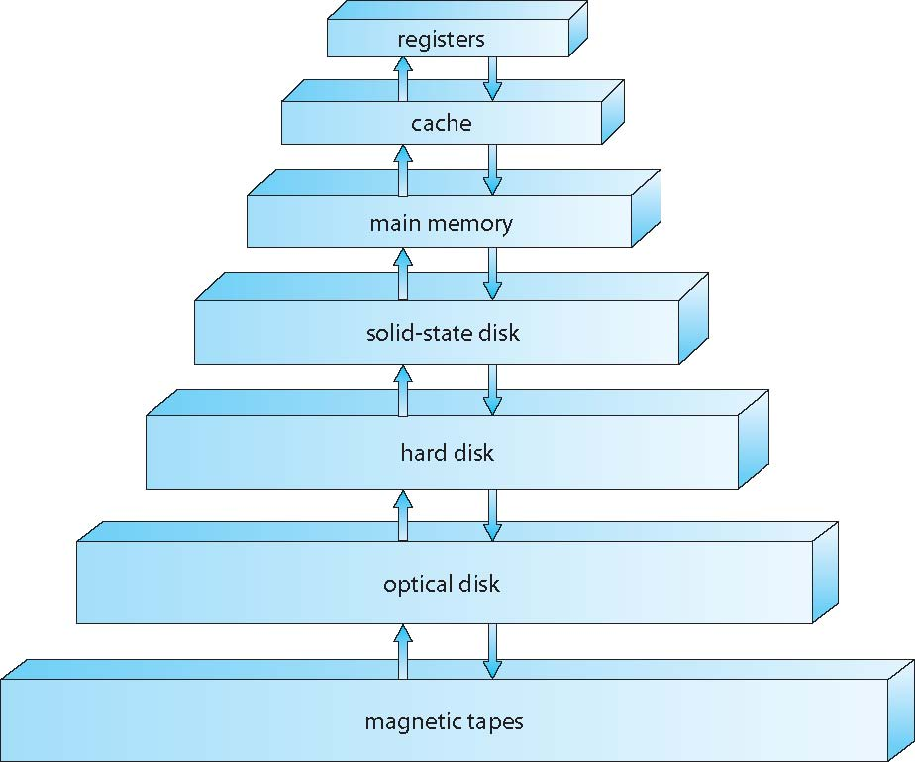
Introduction to OS
Storage-Device Hierarchy
02

Slide 32
Introduction to OS
Caching
Important principle, performed at many levels in a computer (in hardware, operating system, software)
Information in use copied from slower to faster storage temporarily
Faster storage (cache) checked first to determine if information is there
If it is, information used directly from the cache (fast)
If not, data copied to cache and used there
Cache smaller than storage being cached
Cache management important design problem
Cache size and replacement policy
02

Slide 33
Introduction to OS
Basic functions of the operating System
Memory Management
Processor Management
Device Management
File Management
Security
Control over System Performance
Job Accounting
Error Detecting Aids
Coordination b/w other software and users
02

Slide 34
Introduction to OS
Common Operating Systems and Their Differences
Network Operating System
UNIX / Linux / MS Windows2000 Server
Desktop Operating System
MS Windows 9X/Me / Mac OS / DOS
Mobile Operating System
Palm OS and Pocket PC
02

Slide 35
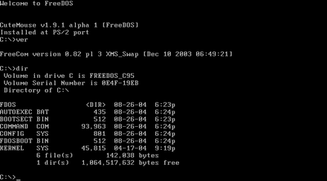
Introduction to OS
DOS interface
02

Slide 36
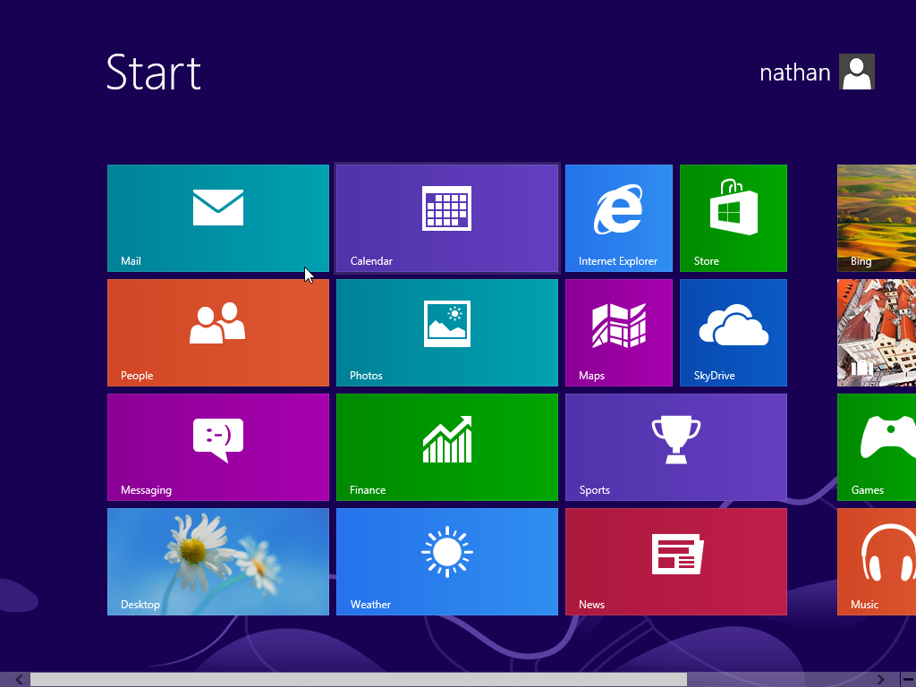
Introduction to OS
GUI
02

Slide 37
Introduction to OS
Different Types of Operating System
UNIX | DOS | Mac OS | MS Windows | Linux | Palm OS/Pocket PC
Multi-user, multi-tasking | Single-user, Single-tasking | Single- user, multi-tasking | Single- user, multi-tasking | Multi-user, multi-tasking | Single- user, multi-tasking
Command-line user interface | Command-line user interface | GUI | GUI | Command-line user interface, GUI | GUI
UNIX has several versions but they lack interoperability | DOS has been replaced by MS Windows OS | Mac OS has easy-to-use GUI | The first true MS OS is MS Windows 95 | Linux is an open-source software | They are specifically designed for PDA
Network OS | Desktop OS | Desktop OS | Desktop OS | Network OS | Mobile OS
02

Slide 38
Summary
What is an Operating System?
Computer System Structure
Components of a Computer System
What Operating System Do?
Operating System Definition
Computer Startup
Computer System Organization
Computer System Operation
Interrupts
I/O Structure
Storage Structure
Storage Hierarchy
Storage Device Hierarchy
Caching
Basic Functions of Operating System
Interfaces
Types of OS

Slide 39
Lecture – 3 , 4, 5

Slide 40
Recap
What is an Operating System?
Computer System Structure
Components of a Computer System
What Operating System Do?
Operating System Definition
Computer Startup
Computer System Organization
Computer System Operation
Interrupts
I/O Structure
Storage Structure
Storage Hierarchy
Storage Device Hierarchy
Caching
Basic Functions of Operating System
Interfaces
Types of OS

Slide 41
Agenda
Operating System Types
OS Structures

Slide 42
Types of OS
Batch processing
Multiprogramming
Time sharing
Parallel
Distributed
Real-time systems
02

Slide 43
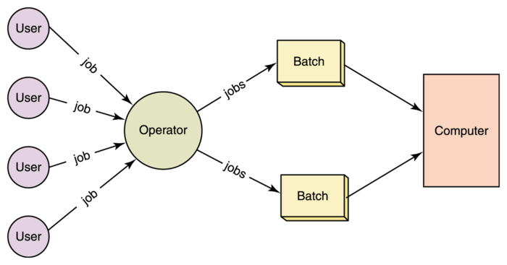
Types of OS
Batch Processing
Jobs and input data are fed into the system in a batch.
The jobs are then run one after another.
No job can be started until the previous job is completed
02

Slide 44
Types of OS
Batch Processing
Advantages
It isn’t easy to guess or know the time required by any job to complete. Processors of the batch systems know how long the job will be when it is in the queue.
Multiple users can share the batch systems.
The processor idle time for batch systems is very low.
It is easy to manage large tasks repeatedly in batch systems.
02

Slide 45
Types of OS
Batch Processing
Disadvantages
The computer operators should have a good understanding of batch systems
Batch systems are hard to debug
It is sometimes costly
The other jobs will have to wait for an unknown time if any job fails
02

Slide 46
Types of OS
Batch Processing
Examples:
Payroll System, Bank Statements etc.,
02

Slide 47
Types of OS
2. Multiprogramming
Multiprogramming is a technique to execute number of programs simultaneously by a single processor.
In Multiprogramming, several processes reside in the main memory at a time.
The OS picks and begins to execute one of the jobs in the main memory.
If any I/O wait happens in a process, then the CPU switches from that job to another job.
Hence CPU is not idle at any time.
02

Slide 48
Types of OS
2. Multiprogramming
Single user cannot keep CPU and I/O devices busy at all times
Multiprogramming organizes jobs (code and data) so the CPU always has one to execute
A subset of total jobs in system is kept in memory
One job selected and run via job scheduling
When it has to wait (for I/O for example), OS switches to another job
02

Slide 49
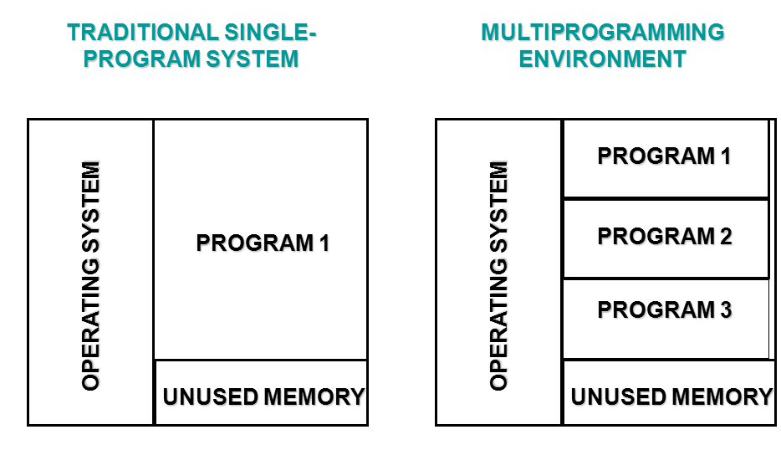
Types of OS
2. Multiprogramming
02

Slide 50
Types of OS
2. Multiprogramming
Advantages:
Efficient memory utilization
Throughput increases
CPU is never idle, so performance increases.
02

Slide 51
Types of OS
2. Multiprogramming
Advantages:
Efficient memory utilization
Throughput increases
CPU is never idle, so performance increases.
02

Slide 52
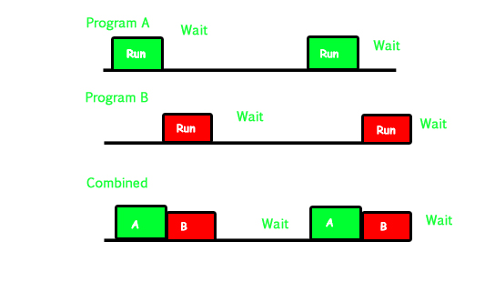
Types of OS
2. Multiprogramming
02

Slide 53
Types of OS
2. Multiprogramming
Examples:
One example is User can use MS Excel, download apps, transfer data from one point to another, Firefox or Google Chrome browser, and more simultaneously.
02

Slide 54
Types of OS
3. Time Sharing
Each user is given a time slice to interact with the CPU.
The size of the time slice will depend on the system.
Each user is served in sequence.
02

Slide 55
Types of OS
3. Time Sharing
is a logical extension in which the CPU switches jobs so frequently that users can interact with each job while it is running, creating interactive computing
Response time should be < 1 second
Each user has at least one program executing in the memory process
If several jobs are ready to run at the same time  CPU scheduling
If processes don’t fit in memory, swapping moves them in and out to run
Virtual memory allows the execution of processes not completely in memory
02

Slide 56
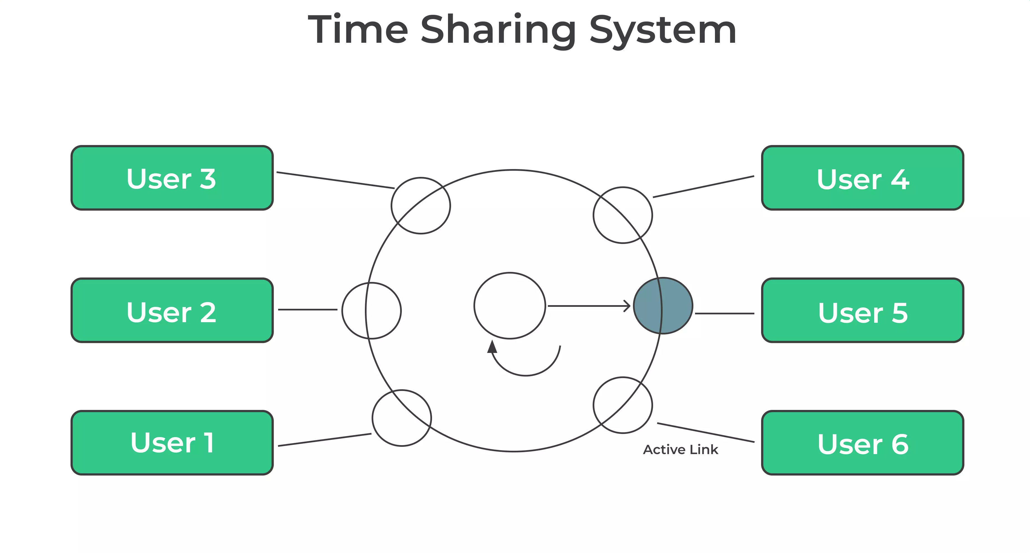
Types of OS
3. Time Sharing
02

Slide 57
Types of OS
3. Time Sharing
Advantages
Each task gets an equal time on the processor
Less chances of duplication of software
CPU idle time can be reduced
02

Slide 58
Types of OS
3. Time Sharing
Disadvantages
The operating system must take care of the security and integrity of user programs and data
Data communication problems can arise if the data storage or users are remotely located
02

Slide 59
Types of OS
3. Time Sharing
Examples
Linux, Unix etc.,
02

Slide 60
Types of OS
4. Parallel Processing
Uses 2 or more CPUs to handle jobs
Computer Networking
02

Slide 61
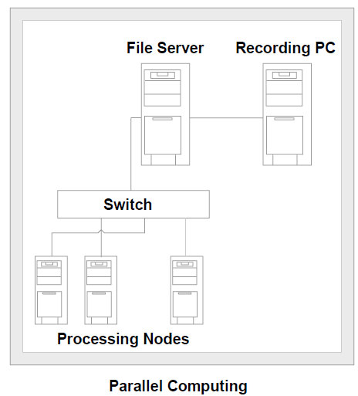
Types of OS
4. Parallel Processing
02

Slide 62
Types of OS
5. Distributed Systems
A distributed system is a collection of independent computers that appear to the users of the system as a single system.
Examples:
Network of workstations
Distributed manufacturing system (e.g., automated assembly line)
Network of branch office computers
02

Slide 63
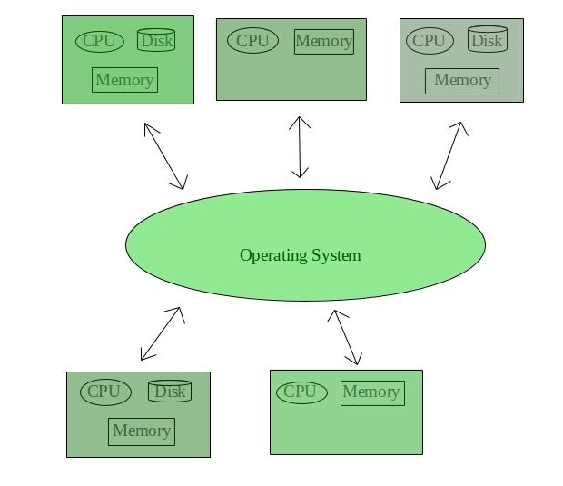
Types of OS
5. Distributed Operating Systems
02

Slide 64
Types of OS
5. Distributed Operating Systems
Advantages:
Data sharing: allow many users to access a common database
Resource Sharing: expensive peripherals like color printers
Communication: enhance human-to-human communication, e.g., email, chat
Flexibility: spread the workload over the available machines
02

Slide 65
Types of OS
5. Distributed Operating Systems
Disadvantages:
Software: difficult to develop software for distributed systems
Network: saturation, lossy transmissions
Security: easy access also applies to secrete data
02

Slide 66
Types of OS
5. Distributed Operating Systems
Example:
LOCUS
02

Slide 67
Types of OS
6. Realtime Operating Systems
These types of OSs are used in real-time systems.
The time interval required to process and respond to inputs is very small.
This time interval is called response time.
02

Slide 68
Types of OS
6. Realtime Operating Systems
Example
anti-missile defense system
airplane landing control system
interrupt error in the computer system
02

Slide 69
Types of OS
6. Realtime Operating Systems
Example
anti-missile defense system
airplane landing control system
interrupt error in the computer system
02

Slide 70
Operating System Structures
A system as large and complex as a modern operating system must be engineered carefully if it is to function properly and be modified easily.
A common approach is to partition the task into small components, or modules, rather than have one monolithic system.
Each of these modules should be a well-defined portion of the system, with carefully defined inputs, outputs, and functions.
02

Slide 71
Operating System Structures
Structures of operating systems tend to differ depending on :
The arrangement of files
How hardware and applications are installed and controlled and
How the user interacts with the system.
02

Slide 72
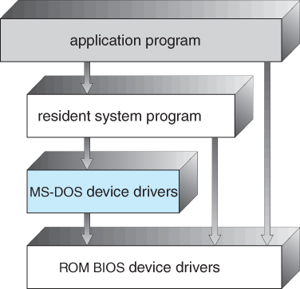
Operating System Structures
1. Simple Structure
MS-DOS has the simplest structure. MS-DOS operating systems are divided into a number of layers; build one on top of the other.
02

Slide 73
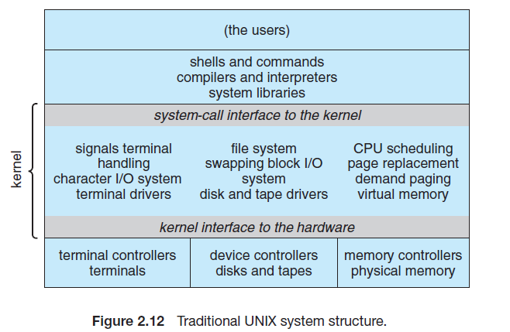
Operating System Structures
1. Simple Structure
Another example of limited structuring is the original UNIX operating system.
Like MS-DOS, UNIX initially was limited by hardware functionality.
It consists of two separable parts: the kernel and the system programs.
02

Slide 74
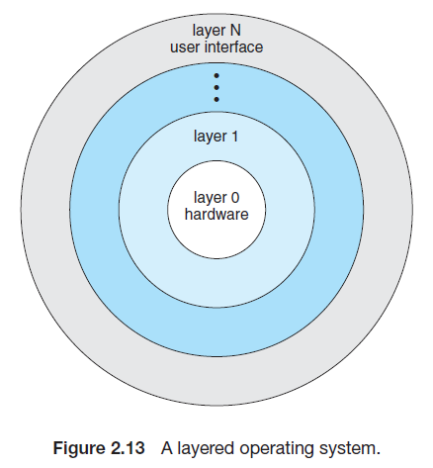
Operating System Structures
2. Layered Structure
A system can be made modular in many ways. One method is the layered approach, in which the operating system is broken up into several layers (levels).
The main advantage of the layered approach is simplicity of construction and debugging
02

Slide 75
Operating System Structures
2. Layered Structure
The major difficulty with the layered approach involves appropriately defining the various layers.
Because a layer can use only lower-level layers, careful planning is necessary.
02

Slide 76
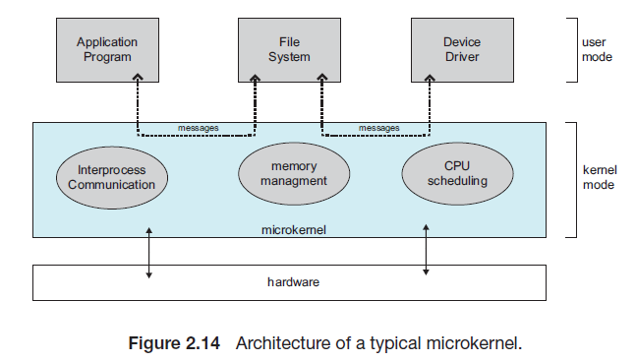
Operating System Structures
3. Micro Kernel Structure
This method structures the operating system by removing all nonessential components from the kernel and implementing them as system and user-level programs.
The result is a smaller kernel.
There is little consensus regarding which services should remain in the kernel and which should be implemented in user space.
Typically, however, microkernels provide minimal process and memory management, in addition to a communication facility.
02

Slide 77
Operating System Structures
3. Micro Kernel Structure
One benefit of the microkernel approach is that it makes extending the operating system easier.
All new services are added to user space and consequently do not require modification of the kernel.
When the kernel does have to be modified, the changes tend to be fewer, because the microkernel is a smaller kernel.
The resulting operating system is easier to port from one hardware design to another.
The microkernel also provides more security and reliability, since most services are running as user—rather than kernel— processes.
If a service fails, the rest of the operating system remains untouched.
02

Slide 78
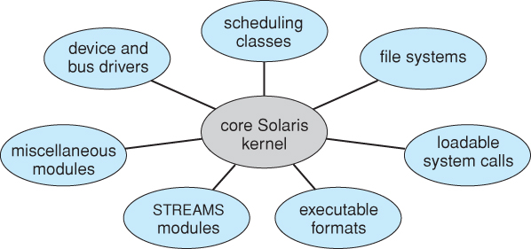
Operating System Structures
4. Modules
The best current methodology for operating-system design involves using loadable kernel modules.
The OS design involves using object-oriented programming techniques to create a modular kernel.
02

Slide 79
Operating System Structures
4. Modules
Here, the kernel has a set of core components and links in additional services via modules, either at boot time or during run time.
This type of design is common in modern implementations of UNIX, such as Solaris, Linux, and Mac OS X, as well as Windows.
The idea of the design is for the kernel to provide core services while other services are implemented dynamically, as the kernel is running.
02

Slide 80
Operating System Structures
5. Hybrid System
In practice, very few operating systems adopt a single, strictly defined structure.
Instead, they combine different structures, resulting in hybrid systems that address performance, security, and usability issues.
Mac OS X
iOS
Android
02

Slide 81
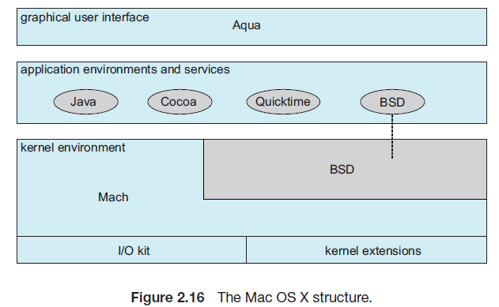
Operating System Structures
5. Hybrid System - Mac OS X
The Apple Mac OS X operating system uses a hybrid structure.
The top layers include the Aqua user interface and a set of application environments and services.
02

Slide 82
Operating System Structures
5. Hybrid System - Mac OS X
The Cocoa environment specifies an API for the Objective-C programming language, which is used for writing Mac OS X applications.
Below these layers is the kernel environment, which consists primarily of the Mach microkernel and the BSD UNIX kernel.
02

Slide 83
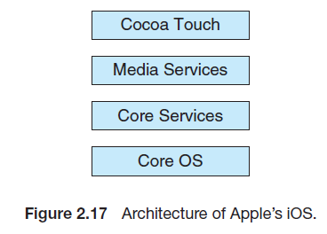
Operating System Structures
5. Hybrid System - iOS
iOS is a mobile operating system designed by Apple to run its smartphone, the iPhone, as well as its tablet computer, the iPad.
iOS is structured on the Mac OS X operating system, with added functionality pertinent to mobile devices, but does not directly run Mac OS X applications.
02

Slide 84
Operating System Structures
5. Hybrid System - iOS
Cocoa Touch is an API for Objective-C that provides several frameworks for developing applications that run on iOS devices.
The media services layer provides services for graphics, audio, and video.
The core services layer provides a variety of features, including support for cloud computing and databases.
The bottom layer represents the core operating system, which is based on the kernel environment
02

Slide 85
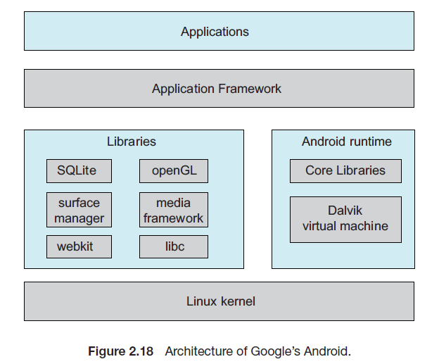
Operating System Structures
5. Hybrid System - Android
The Android operating system was designed by the Open Handset Alliance (led primarily by Google) and was developed for Android smartphones and tablet computers.
Android is similar to iOS in that it is a layered stack of software that provides a rich set of frameworks for developing mobile applications
02

Slide 86
Operating System Structures
5. Hybrid System - Android
At the bottom of this software stack is the Linux kernel, although it has been modified by Google and is currently outside the normal distribution of Linux releases.
The Android runtime environment includes a core set of libraries as well as the Dalvik virtual machine.
The set of libraries available for Android applications includes frameworks for developing web browsers (webkit), database support (SQLite), and multimedia.
02

Slide 87
Summary
Types of OS
OS Structures

Slide 88
Lecture – 6

Slide 89
Recap
Types of OS
OS Structures

Slide 90
Agenda
Operating System Components
Operating System Services
System Calls
System Programs

Slide 91
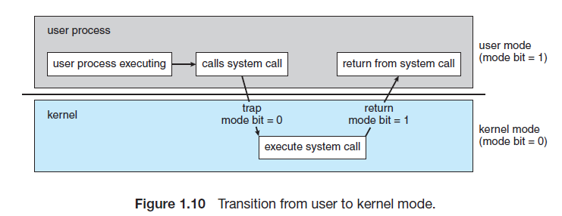
Operating System Operation
02

Slide 92
Operating System Components
The components of an operating system all exist to make the different parts of a computer work together. The OS consists of the following 4 components :
Kernel
Networking
Security
User Interface.
02

Slide 93
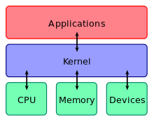
Operating System Components
Kernel
A kernel connects the application software to the hardware of a computer.
02

Slide 94
Operating System Components
Kernel
The different tasks performed by a kernel include:
Program Execution
Interrupts
Modes
Memory management
Multitasking
Disk access and file systems
Device drivers
02

Slide 95
Operating System Components
2. Networking
The computers running dissimilar operating systems can participate in a common network for sharing resources such as computing, files, printers, and scanners using either wired or wireless connections.
02

Slide 96
Operating System Components
3. Security
The operating system must be capable of distinguishing between requests that should be allowed to be processed, and others that should not be processed.
02

Slide 97
Operating System Components
4. User Interface
Every computer that is to be operated by an individual requires a user interface.
The two most common forms of a user interface have been :
Command Line Interface
Graphical User Interface
02

Slide 98
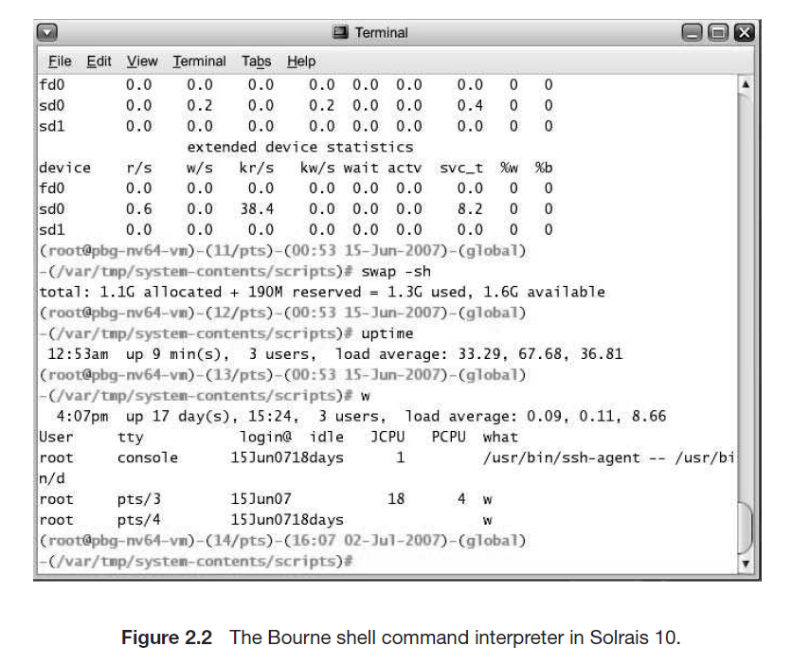
Operating System Components
Command Line Interface
4. User Interface
02

Slide 99

Operating System Components
Graphical User Interface
4. User Interface
02

Slide 100
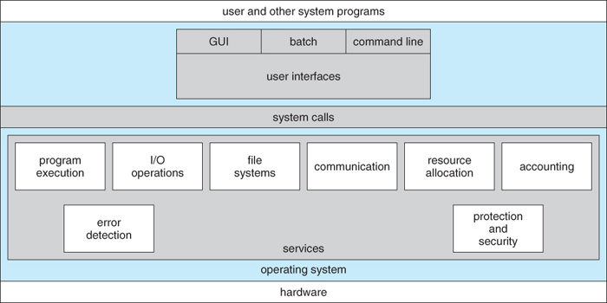
Operating System Services
OS provides certain services to programs and to the users of those programs.
02

Slide 101
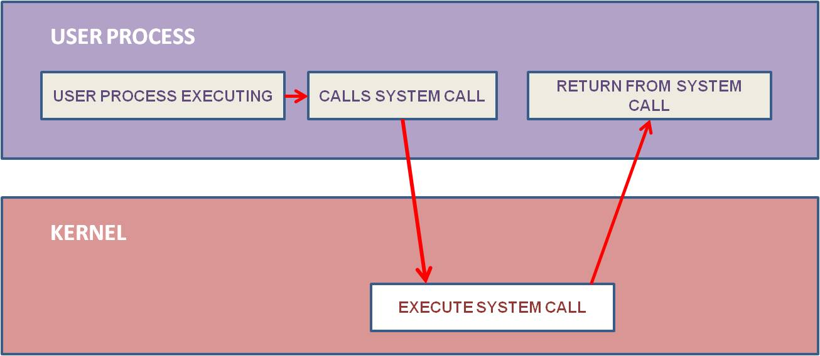
System Calls
In computing, a system call is the programmatic way in which a computer program requests a service from the kernel of the operating system it is executed on.
02

Slide 102
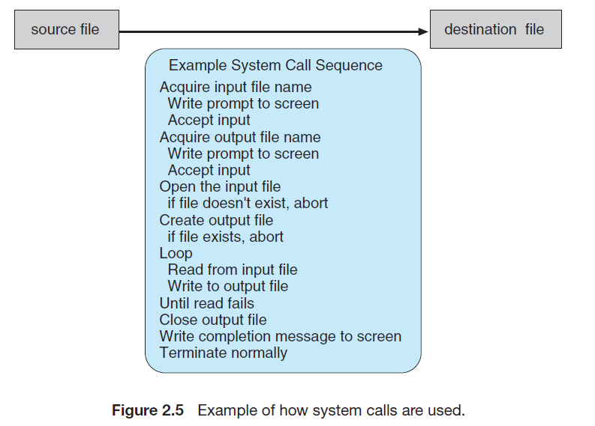
System Calls
Example:
To illustrate how system calls are used:
write a simple program to read data from one file and copy them to another file.
02

Slide 103
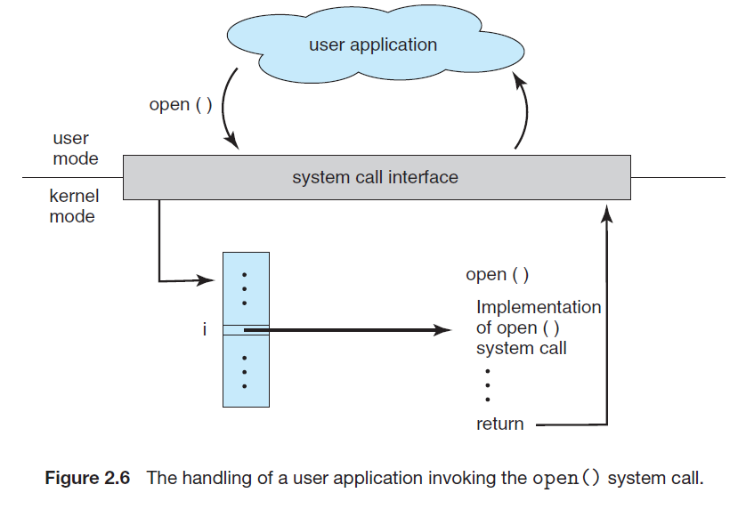
System Calls
Example:
02

Slide 104
System Calls
Types of System Calls:
System calls can be grouped roughly into five major categories:
Process control
File Management
Device Management
Information Maintenance
Communications.
02

Slide 105
System Calls
Types of System Calls:
Process control:
System Calls for Process Control:
end, abort, load, execute, create process, terminate the process, get process attributes, set process attributes, wait for time, wait for event, signal event, allocate, and free memory
02

Slide 106
System Calls
Types of System Calls:
2. File Management:
System Calls for File Management:
create file, delete file, open, close read, write, reposition, get file attributes, set file attributes
02

Slide 107
System Calls
Types of System Calls:
3. Device Management:
System Calls for Device Management:
create file, delete file, open, close read, write, reposition, get file attributes, set file attributes
02

Slide 108
System Calls
Types of System Calls:
4. Information Maintenance:
System Calls for Information Maintenance:
get time or date, set time or date, get system data, set system data, get process, file, or device attributes, set process, file, or device attributes
02

Slide 109
System Calls
Types of System Calls:
5. Communication:
System Calls for Communication:
create, delete communication connections, send, and receive messages, transfer status information attach or detach remote devices
02

Slide 110
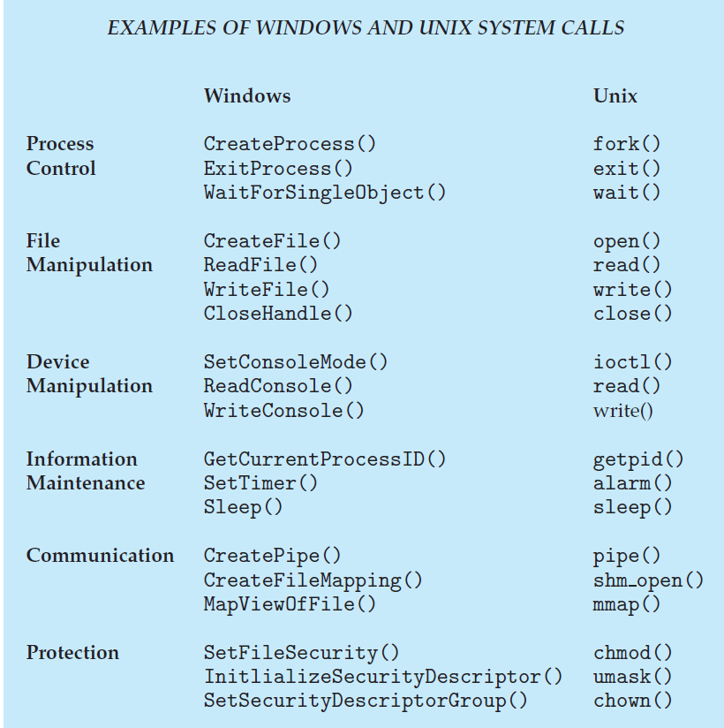
System Calls
Types of System Calls:
02

Slide 111
System Programs
System programs also known as system utilities provide a convenient environment for program development and execution. They can be divided into the following categories:
File management
Status Information
File modification
Programming-language support
Program loading and execution
Communications
02

Slide 112
Summary
Operating System Components
Operating System Services
System Calls
System Programs

Slide 113
Lecture – 7

Slide 114
Recap
Operating System Components
Operating System Services
System Calls
System Programs

Slide 115
Agenda
Process Management

Slide 116
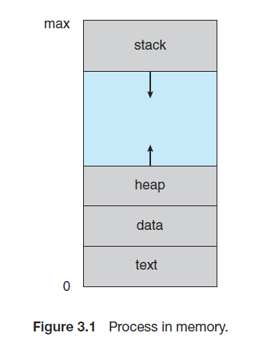
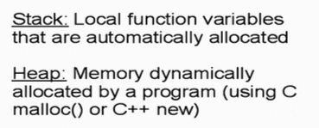
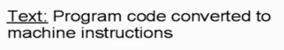
Process Concept
A process is a program in execution.
02

Slide 117
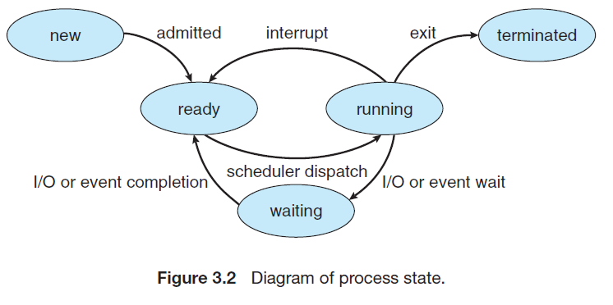
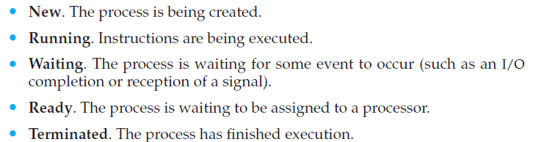
Process States
As a process executes, it changes state. The state of a process is defined in part by the current activity of that process. A process may be in one of the following states:
02

Slide 118
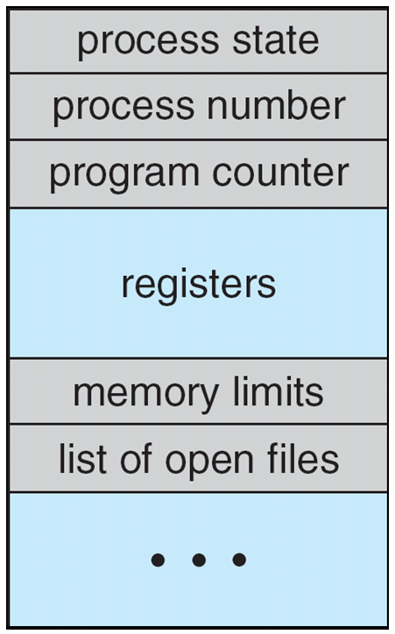
Process Control Block
Information associated with each process
(also called task control block)
Process state – running, waiting, etc
Program counter – location of instruction to next execute
CPU registers – contents of all process-centric registers
CPU scheduling information- priorities, scheduling queue pointers
Memory-management information – memory allocated to the process
Accounting information – CPU used, clock time elapsed since start, time limits
I/O status information – I/O devices allocated to process, list of open files
02

Slide 119
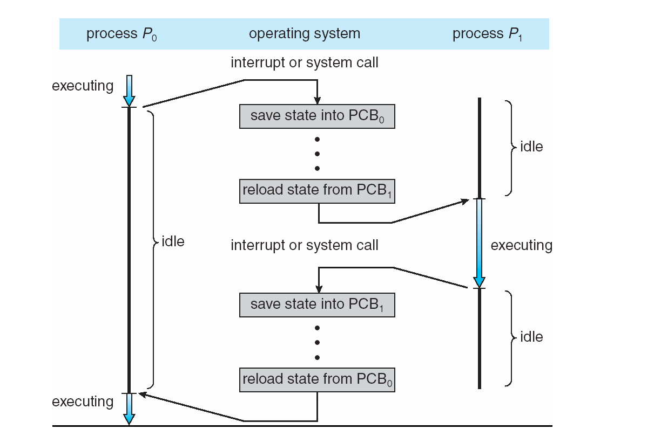
CPU Switch From Process to Process
02

Slide 120
Lecture – 8

Slide 121
Recap
Process Concept
Process States
Process Control Block
CPU Switch

Slide 122
Agenda
Threads
Process Scheduling
Scheduling Queues

Slide 123
Threads
So far, process has a single thread of execution
Consider having multiple program counters per process
Multiple locations can execute at once
Multiple threads of control -> threads
Must then have storage for thread details, multiple program counters in PCB
02

Slide 124
Scheduling Queues
Maximize CPU use, quickly switch processes onto CPU for time-sharing
Process scheduler selects among available processes for the next execution on CPU
Maintains scheduling queues of processes
Job queue – set of all processes in the system
Ready queue – set of all processes residing in main memory, ready and waiting to execute
Device queues – set of processes waiting for an I/O device
Processes migrate among the various queues
02

Slide 125
Process Scheduling
The act of determining which process in the ready state should be moved to the running state is known as Process Scheduling.
Schedulers fall into one of the two general categories:
Non-pre-emptive scheduling: When the currently executing process gives up the CPU voluntarily.
Pre-emptive scheduling: When the operating system favors another process, pre-empting the currently executing process.
02

Slide 126
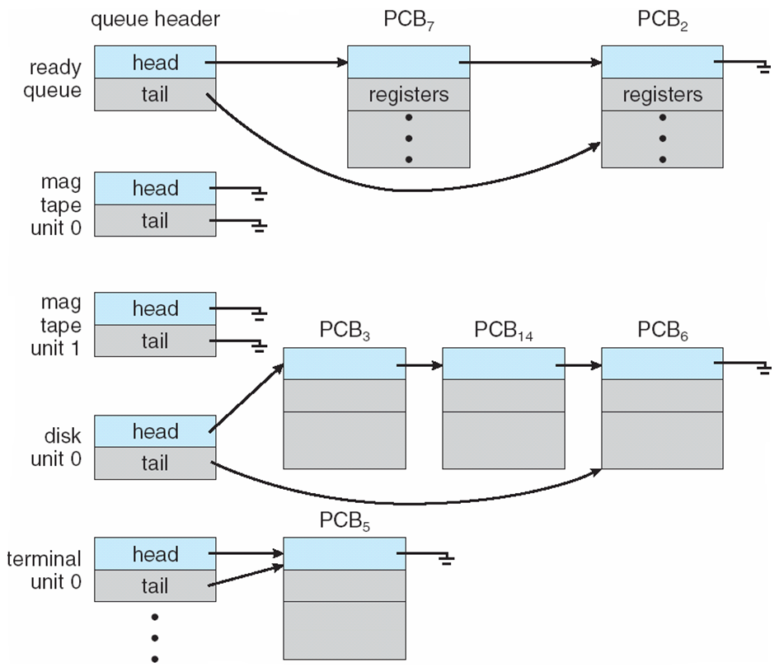
Ready Queue And Various I/O Device Queues
02

Slide 127
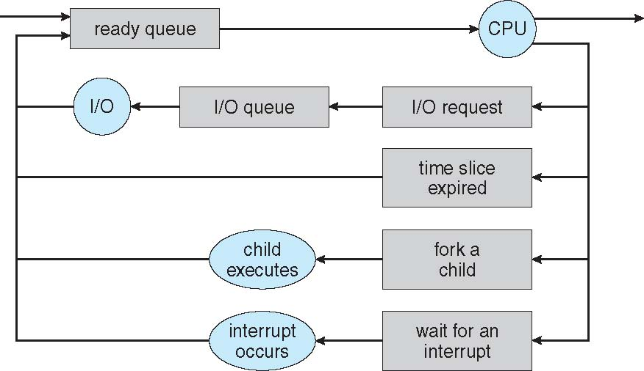
Representation of Process Scheduling
Queueing diagram represents queues, resources, flows
02

Slide 128
Schedulers
Short-term scheduler (or CPU scheduler) – selects which process should be executed next and allocates CPU
Sometimes the only scheduler in a system
Short-term scheduler is invoked frequently (milliseconds) ⇒ (must be fast)
Long-term scheduler (or job scheduler) – selects which processes should be brought into the ready queue
Long-term scheduler is invoked infrequently (seconds, minutes) ⇒ (may be slow)
The long-term scheduler controls the degree of multiprogramming
Processes can be described as either:
I/O-bound process – spends more time doing I/O than computations, many short CPU bursts
CPU-bound process – spends more time doing computations; few very long CPU bursts
Long-term scheduler strives for good process mix
02

Slide 129
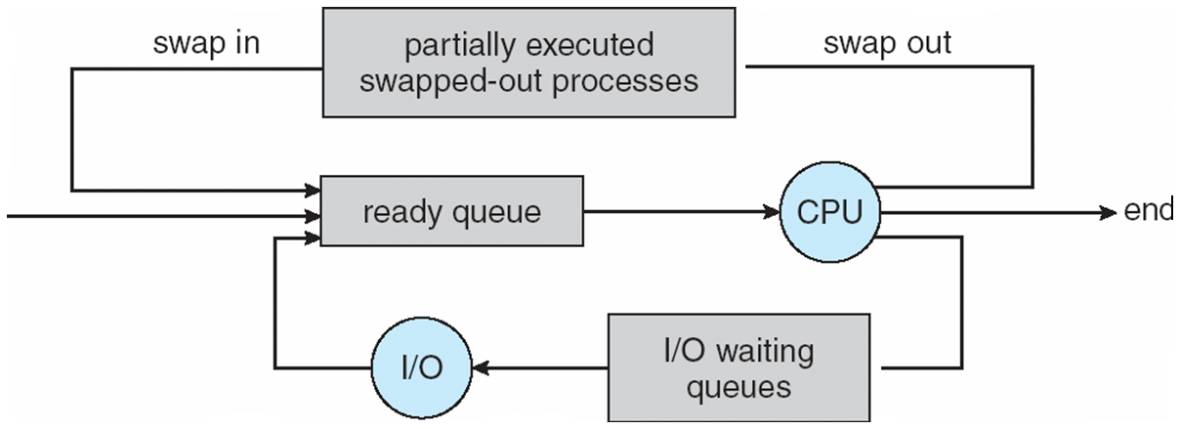
Addition of Medium Term Scheduling
A Medium-term scheduler can be added if the degree of multiple programming needs to decrease
Remove process from memory, store on disk, bring back in from disk to continue execution: swapping
02

Slide 130
Lecture – 9

Slide 131
Recap
Threads
Process Scheduling
Scheduling Queues

Slide 132
Agenda
Interprocess Communication
CPU Scheduling

Slide 133
Inter process Communication
Processes within a system may be independent or cooperating
Cooperating process can affect or be affected by other processes, including sharing data
Reasons for cooperating processes:
Information sharing
Computation speedup
Modularity
Convenience
Cooperating processes need interprocess communication (IPC)
Two models of IPC
Shared memory
Message passing
02

Slide 134
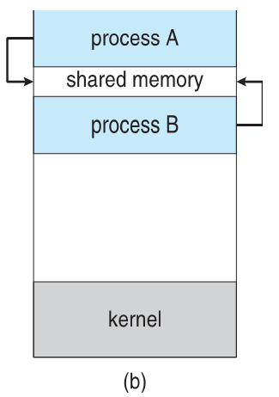
Inter process Communication
(a) Message passing.
(b) shared memory.
02

Slide 135
Inter process Communication
Shared Memory.
An area of memory shared among the processes that wish to communicate.
The users control the communication processes, not the operating system.
Major issues are to provide a mechanism that will allow the user processes to synchronize their actions when they access shared memory.
02

Slide 136
Inter process Communication
Message Passing
Mechanism for processes to communicate and to synchronize their actions
Message system – processes communicate with each other without resorting to shared variables
IPC facility provides two operations:
send(message)
receive(message)
The message size is either fixed or variable
02

Slide 137
Inter process Communication
Message Passing
If processes P and Q wish to communicate, they need to:
Establish a communication link between them
Exchange messages via send/receive
Implementation issues:
How are links established?
Can a link be associated with more than two processes?
How many links can there be between every pair of communicating processes?
What is the capacity of a link?
Is the size of a message that the link can accommodate fixed or variable?
Is a link unidirectional or bi-directional?
02

Slide 138
Inter process Communication
Message Passing
Implementation of communication link
Physical:
Shared memory
Hardware bus
Network
Logical:
Direct or indirect
Synchronous or asynchronous
Automatic or explicit buffering
02

Slide 139
Inter process Communication
Message Passing – Direct Communication
Processes must name each other explicitly:
send (P, message) – send a message to process P
receive(Q, message) – receive a message from process Q
Properties of communication link
Links are established automatically
A link is associated with exactly one pair of communicating processes
Between each pair there exists exactly one link
The link may be unidirectional but is usually bi-directional
02

Slide 140
Inter process Communication
Message Passing – Indirect Communication
Messages are directed and received from mailboxes (also referred to as ports)
Each mailbox has a unique id
Processes can communicate only if they share a mailbox
Properties of communication link
Link established only if processes share a common mailbox
A link may be associated with many processes
Each pair of processes may share several communication links
Link may be unidirectional or bi-directional
02

Slide 141
Inter process Communication
Message Passing – Indirect Communication
Operations
create a new mailbox (port)
send and receive messages through mailbox
destroy a mailbox
Primitives are defined as:
send(A, message) – send a message to mailbox A
receive(A, message) – receive a message from mailbox A
02

Slide 142
Inter process Communication
Message Passing – Indirect Communication
Mailbox sharing
P1, P2, and P3 share mailbox A
P1, sends; P2 and P3 receive
Who gets the message?
Solutions
Allow a link to be associated with at most two processes
Allow only one process at a time to execute a receive operation
Allow the system to select arbitrarily the receiver. The sender is notified of who the receiver was.
02

Slide 143
Inter process Communication
Message Passing – Synchronization
Communication between processes takes place through calls to send() and receive() primitives. There are different design options for implementing each primitive.
Message passing may be either blocking or non-blocking
Blocking is considered synchronous
Blocking send -- the sender is blocked until the message is received
Blocking receive -- the receiver is blocked until a message is available
Non-blocking is considered asynchronous
Non-blocking send -- the sender sends the message and continue
Non-blocking receive -- the receiver receives:
A valid message, or
Null message
Different combinations possible
If both send and receive are blocked, we have a rendezvous
02

Slide 144
Inter process Communication
Message Passing – Buffering
Queue of messages attached to the link.
implemented in one of three ways
Zero capacity – no messages are queued on a link. The sender must wait for the receiver (rendezvous)
Bounded capacity – finite length of n messages The sender must wait if the link full
Unbounded capacity – infinite length Sender never waits
02

Slide 145
Inter process Communication
Message Passing – Buffering
Queue of messages attached to the link.
implemented in one of three ways
Zero capacity – no messages are queued on a link. The sender must wait for the receiver (rendezvous)
Bounded capacity – finite length of n messages The sender must wait if the link full
Unbounded capacity – infinite length Sender never waits
02

Slide 146
Inter process Communication
Examples ???
02

Slide 147
Lecture – 10

Slide 148
Recap
Interprocess Communication

Slide 149
Agenda
CPU Scheduling

Slide 150
CPU Scheduling
In a single-processor system, only one process can run at a time. Others must wait until the CPU is free and can be rescheduled.
The objective of multiprogramming is to have some process running at all times, to maximize CPU utilization.
A process is executed until it must wait, typically for the completion of some I/O request.
In a simple computer system, the CPU then just sits idle. All this waiting time is wasted; no useful work is accomplished.
With multiprogramming, we try to use this time productively. Several processes are kept in memory at one time.
02

Slide 151
CPU Scheduling
When one process has to wait, the operating system takes the CPU away from that process and gives the CPU to another process. This pattern continues.
Every time one process has to wait, another process can take over the use of the CPU.
Scheduling of this kind is a fundamental operating system function.
02

Slide 152
CPU Scheduling
CPU–I/O Burst Cycle
Maximum CPU utilization obtained with multiprogramming
CPU–I/O Burst Cycle – Process execution consists of a cycle of CPU execution and I/O wait
CPU burst followed by I/O burst
CPU burst distribution is of main concern
02

Slide 153
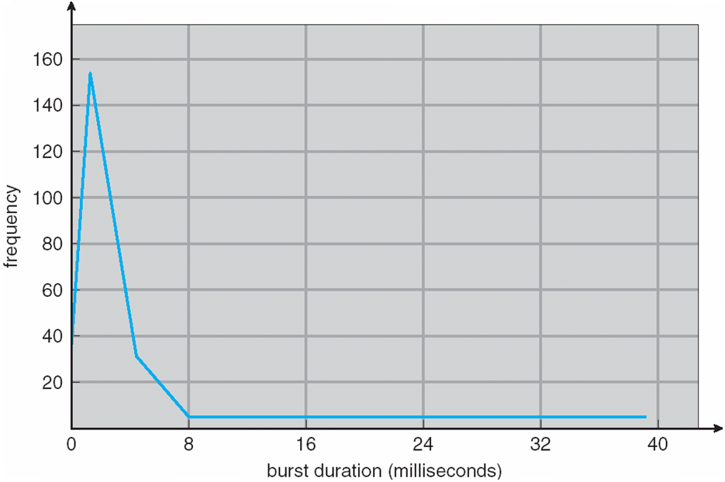
CPU Scheduling
CPU–I/O Burst Cycle
The durations of CPU bursts have been measured extensively.
Although they vary greatly from process to process and from computer to computer, they tend to have a frequency curve
02

Slide 154
CPU Scheduling
CPU Scheduler
Short-term scheduler selects from among the processes in the ready queue, and allocates the CPU to one of them
Queue may be ordered in various ways
CPU scheduling decisions may take place when a process:
1. Switches from running to waiting state
2. Switches from running to ready state
3. Switches from waiting to ready
Terminates
Scheduling under 1 and 4 is nonpreemptive
All other scheduling is preemptive
Consider access to shared data
Consider preemption while in kernel mode
Consider interrupts occurring during crucial OS activities
02

Slide 155
CPU Scheduling
Dispatcher
Dispatcher module gives control of the CPU to the process selected by the short-term scheduler; this involves:
switching context
switching to user mode
jumping to the proper location in the user program to restart that program
Dispatch latency – time it takes for the dispatcher to stop one process and start another running
02

Slide 156
CPU Scheduling
Scheduling Criteria
CPU utilization – keep the CPU as busy as possible
Throughput – # of processes that complete their execution per time unit
Turnaround time – the amount of time to execute a particular process
Waiting time – the amount of time a process has been waiting in the ready queue
Response time – the amount of time it takes from when a request was submitted until the first response is produced, not output (for the time-sharing environment)
02

Slide 157
Lecture – 11

Slide 158
Recap
CPU Scheduling

Slide 159
Agenda
CPU Scheduling Algorithms
FCFS
SJF
Priority

Slide 160
CPU Scheduling
Scheduling Algorithms
First-Come, First-Served Scheduling
Shortest-Job-First Scheduling
Priority Scheduling
02

Slide 161
CPU Scheduling
Scheduling Algorithms -
First-Come, First-Served (FCFS) Scheduling
Process Burst Time
P₁ 24
P₂ 3
P₃ 3
Suppose that the processes arrive in the order: P₁, P₂ , P₃ The Gantt Chart for the schedule is:
Waiting time for P₁ = 0; P₂ = 24; P₃ = 27
Average waiting time: (0 + 24 + 27)/3 = 17
02

Slide 162
CPU Scheduling
Scheduling Algorithms -
First-Come, First-Served (FCFS) Scheduling
Suppose that the processes arrive in the order: P₂ , P₃ , P₁
The Gantt chart for the schedule is:
Waiting time for P₁ = 6; P₂ = 0; P₃ = 3
Average waiting time: (6 + 0 + 3)/3 = 3
Much better than the previous case
02

Slide 163
CPU Scheduling
Scheduling Algorithms -
Shortest Job First (SJF) Scheduling
Associate with each process the length of its next CPU burst
Use these lengths to schedule the process in the shortest time
SJF is optimal – gives minimum average waiting time for a given set of processes
The difficulty is knowing the length of the next CPU request
Could ask the user
02

Slide 164
CPU Scheduling
Scheduling Algorithms -
Shortest Job First (SJF) Scheduling
ProcessArriva l Time Burst Time
P₁ 0.0 6
P₂ 2.0 8
P₃ 4.0 7
P₄ 5.0 3
SJF scheduling chart
Average waiting time = (3 + 16 + 9 + 0) / 4 = 7
02

Slide 165
CPU Scheduling
Scheduling Algorithms -
Shortest Job First (SJF) Scheduling
Now we add the concepts of varying arrival times and preemption to the analysis
Process Arrival Time Burst Time
P1 0 8
P2 1 4
P3 2 9
P4 3 5
Preemptive SJF Gantt Chart
Average waiting time = [(10-1)+(1-1)+(17-2)+5-3)]/4 = 26/4 = 6.5 msec
02

Slide 166
CPU Scheduling
Scheduling Algorithms -
Priority Scheduling
A priority number (integer) is associated with each process
The CPU is allocated to the process with the highest priority (smallest integer ≡ highest priority)
Preemptive
Nonpreemptive
SJF is priority scheduling where priority is the inverse of predicted next CPU burst time
Problem ≡ Starvation – low priority processes may never execute
Solution ≡ Aging – as time progresses increase the priority of the process
02

Slide 167
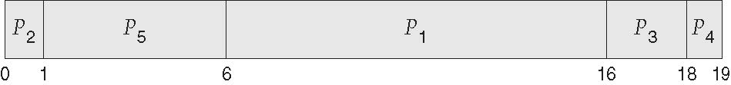
CPU Scheduling
Scheduling Algorithms -
Priority Scheduling
ProcessA arri Burst TimeT Priority
P₁ 10 3
P₂ 1 1
P₃ 2 4
P₄ 1 5
P₅ 5 2
Priority scheduling Gantt Chart
Average waiting time = 8.2 msec
02

Slide 168
CPU Scheduling
Scheduling Algorithms -
Priority Scheduling
Job | Time (ms) | Arrival | Priority
1 | 8 | 0 | 3
2 | 4 | 1 | 2
3 | 6 | 2 | 1
4 | 1 | 3 | 4
02

Slide 169
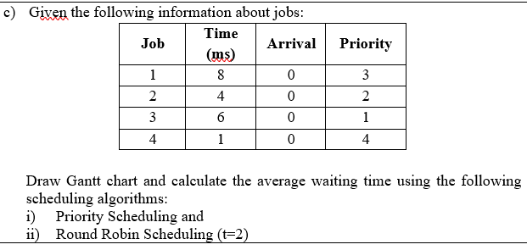
CPU Scheduling
Scheduling Algorithms -
Priority Scheduling
02

Slide 170
Lecture – 12

Slide 171
Recap
CPU Scheduling Algorithms
FCFS
SJF
Priority

Slide 172
Recap
CPU Scheduling Algorithms
Round Robin Scheduling

Slide 173
CPU Scheduling
Scheduling Algorithms -
Round Robin Scheduling
Each process gets a small unit of CPU time (time quantum q), usually 10-100 milliseconds. After this time has elapsed, the process is preempted and added to the end of the ready queue.
If there are n processes in the ready queue and the time quantum is q, then each process gets 1/n of the CPU time in chunks of at most q time units at once. No process waits more than (n-1)q time units.
The timer interrupts every quantum to schedule the next process
02

Slide 174
CPU Scheduling
Scheduling Algorithms -
Round Robin Scheduling
Process Burst Time
P₁ 24
P₂ 3
P₃ 3
The Gantt chart is: Typically, higher average turnaround than SJF, but a better response
02

Slide 175
Multiprocessor Scheduling
CPU scheduling is more complex when multiple CPUs are available
Concerns In Multiprocessor Scheduling
Homogeneous processors within a multiprocessor
Asymmetric multiprocessing – only one processor accesses the system data structures, alleviating the need for data sharing
Symmetric multiprocessing (SMP) – each processor is self-scheduling, all processes in a common ready queue, or each has its private queue of ready processes
Currently, the most common
02

Slide 176
Multiprocessor Scheduling
Concerns In Multiprocessor Scheduling
Processor affinity – the process has an affinity for processor on which it is currently running
soft affinity - When an operating system has a policy of attempting to keep a process running on the same processor—but not guarantee that it will do so—
hard affinity - allowing a process to specify a subset of processors on which it may run.
02

Slide 177
Process Synchronization
Processes can execute concurrently
May be interrupted at any time, partially completing execution
Concurrent access to shared data may result in data inconsistency
Maintaining data consistency requires mechanisms to ensure the orderly execution of cooperating processes
02

Slide 178
Process Synchronization
Process Synchronization means sharing system resources by processes in a way that, Concurrent access to shared data is handled thereby minimizing the chance of inconsistent data.
02

Slide 179
Producer-Consumer Problem
In computing, the producer–consumer problem (also known as the bounded-buffer problem) is a classic example of a process synchronization problem.
02

Slide 180
Producer-Consumer Problem
There is one Producer in the producer-consumer problem, the Producer is producing some items, whereas there is one Consumer that is consuming the items produced by the Producer.
The same memory buffer is shared by both producers and consumers which is of fixed size.
02

Slide 181
Producer-Consumer Problem
The task of the Producer is to produce the item, put it into the memory buffer, and again start producing items.
Whereas the task of the Consumer is to consume the item from the memory buffer.
02

Slide 182
Producer-Consumer Problem
Below are a few points that are considered as the problems that occur in Producer-Consumer:
The producer should produce data only when the buffer is not full. In case it is found that the buffer is full, the producer is not allowed to store any data into the memory buffer.
Data can only be consumed by the consumer if and only if the memory buffer is not empty. In case it is found that the buffer is empty, the consumer is not allowed to use any data from the memory buffer.
Accessing memory buffer should not be allowed to producer and consumer at the same time.
02

Slide 183
Producer-Consumer Problem
PRODUCER PROCESS:
item nextProduced;
while (true)
{
/* produce an item in nextProduced */
while (((in + 1) % BUFFER-SIZE) == out) ;
/* do nothing */
buffer[in] = nextProduced;
in = (in + 1) % BUFFER_SIZE;
}
CONSUMER PROCESS:
item nextConsumed;
while (true)
{
while (in == out) ;
//do nothing
nextConsumed = buffer[out];
out = (out + 1) % BUFFEFLSIZE;
/* consume the item in nextConsumed */
}
02

Slide 184
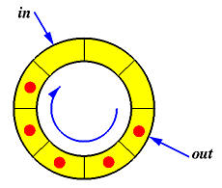
Producer-Consumer Problem
Fig : Circular Array representing producer-consumer process
02

Slide 185
Producer-Consumer Problem
Suppose we want to modify the algorithm to remedy this deficiency. One possibility is to add an integer variable counter, initialized to 0.
PRODUCER PROCESS:
while (true)
{ /* produce an item in nextProduced */
while (counter == BUFFER.SIZE) ;
/* do nothing */
buffer[in] = nextProduced; in = (in + 1) % BUFFER-SIZE;
counter++;
}
02

Slide 186
Producer-Consumer Problem
CONSUMER PROCESS:
while (true)
{
while (counter == 0) ;
/* do nothing */
nextConsumed = buffer [out] ,
out = (out + 1) % BUFFER_SIZE;
counter--;
/* consume the item in nextConsumed */
}
02

Slide 187
Producer-Consumer Problem
As an illustration, suppose that the value of the variable counter is currently 5 and that the producer and consumer processes concurrently execute the statements “counter++” and “counter--”.
Following the execution of these two statements, the value of the variable counter may be 4, 5, or 6!
The only correct result, though, is counter == 5, which is generated correctly if the producer and consumer execute separately.
02

Slide 188
Producer-Consumer Problem
counter++ could be implemented as register1 = counter register1 = register1 + 1 counter = register1
counter-- could be implemented as register2 = counter register2 = register2 - 1 counter = register2
Consider this execution interleaving with “count = 5” initially:
S0: producer execute register1 = counter {register1 = 5} S1: producer execute register1 = register1 + 1 {register1 = 6} S2: consumer execute register2 = counter {register2 = 5} S3: consumer execute register2 = register2 – 1 {register2 = 4} S4: producer execute counter = register1 {counter = 6 } S5: consumer execute counter = register2 {counter = 4}
02

Slide 189
Producer-Consumer Problem
We would arrive at this incorrect state because we allowed both processes to manipulate the variable counter concurrently.
A situation like this, where several processes access and manipulate the same data concurrently and the outcome of the execution depends on the particular order in which the access takes place, is called a race condition.
02

Slide 190
Lecture – 12

Slide 191
Recap
CPU Scheduling Algorithms
Round Robin Scheduling
Process Synchronization
Producer Consumer Problem

Slide 192
Agenda
The Critical Section Problem
Synchronization Hardware

Slide 193
The Critical Section Problem
Consider system of n processes {p₀, p₁, … p_{n-1}}
Each process has a critical section segment of code
Process may be changing common variables, updating the table, writing file, etc
When one process is in the critical section, no other may be in its critical section
The Critical section problem is to design a protocol to solve this
Each process must ask permission to enter the critical section in the entry section, may follow the critical section with the exit section, then the remainder section
02

Slide 194
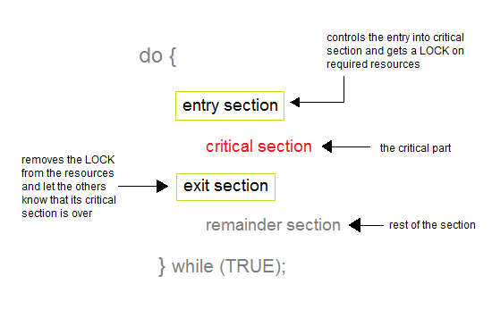
The Critical Section Problem
A Critical Section is a code segment that accesses shared variables and has to be executed as an atomic action.
02

Slide 195
The Critical Section Problem
Solution to the Critical Section Problem
A solution to the critical section problem must satisfy the following three conditions :
Mutual Exclusion
Progress
Bounded Waiting
02

Slide 196
The Critical Section Problem
Mutual Exclusion - If process P_{i} is executing in its critical section, then no other processes can be executing in their critical sections
Progress - If no process is executing in its critical section and there exist some processes that wish to enter their critical section, then the selection of the processes that will enter the critical section next cannot be postponed indefinitely
Bounded Waiting - A bound must exist on the number of times that other processes are allowed to enter their critical sections after a process has made a request to enter its critical section and before that request is granted
02

Slide 197
Synchronization Hardware
Many systems provide hardware support for implementing the critical section code.
All solutions below are based on the idea of locking
Protecting critical regions via locks
Uniprocessors – could disable interrupts
Currently running code would execute without preemption
Generally too inefficient on multiprocessor systems
Operating systems using this not broadly scalable
Modern machines provide special atomic hardware instructions
Atomic = non-interruptible
Either test memory word and set value
Or swap contents of two memory words
02

Slide 198
Synchronization Hardware
Any solution to the critical-section problem requires a simple tool—a lock
do {
critical section
remainder section
}
while (TRUE);
acquire lock
02

Slide 199
Lecture – 13

Slide 200
Recap
The Critical Section Problem
Synchronization Hardware

Slide 201
Agenda
Semaphore
Classical Problems of Synchronization

Slide 202
Semaphore
Synchronization tool that provides more sophisticated ways for processes to synchronize their activities.
Semaphore S – integer variable
Can only be accessed via two indivisible (atomic) operations
wait() and signal()
Originally called P() and V()
Definition of the wait() operation
wait(S) {
while (S <= 0)
; // busy-wait
S--;
}
Definition of the signal() operation
signal(S) {
S++;
}
02

Slide 203
Semaphore
A semaphore, in its most basic form, is a protected integer variable that can facilitate and restrict access to shared resources in a multi-processing environment.
The two most common kinds of semaphores are
Counting semaphores and
Binary semaphores.
02

Slide 204
Semaphore
Counting semaphore – integer value can range over an unrestricted domain
Binary semaphore – integer value can range only between 0 and 1
Same as a mutex lock
Can solve various synchronization problems
Consider P₁ and P₂ that require S₁ to happen before S₂
Create a semaphore “synch” initialized to 0
P1:
S₁;
signal(synch);
P2:
wait(synch);
S₂;
Can implement a counting semaphore S as a binary semaphore
02

Slide 205
Semaphore Implementation
Must guarantee that no two processes can execute the wait() and signal() on the same semaphore at the same time
Thus, the implementation becomes the critical section problem where the wait and signal code are placed in the critical section
Could now have busy waiting in critical section implementation
But implementation code is short
Little busy waiting if critical section rarely occupied
Note that applications may spend lots of time in critical sections and therefore this is not a good solution
02

Slide 206
Semaphore Implementation
Properties of Semaphores :
Simple
Works with many processes
Can have many different critical sections with different semaphores
Each critical section has unique access semaphores
Can permit multiple processes into the critical section at once, if desirable.
02

Slide 207
Semaphore Implementation
Limitations of Semaphores
Priority Inversion is a big limitation on semaphores.
Their use is not enforced but is by convention only.
With improper use, a process may be blocked indefinitely. Such a situation is called a Deadlock.
02

Slide 208
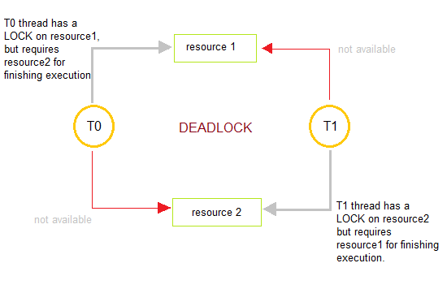
Deadlock and Starvation
Deadlocks are a set of blocked processes each holding a resource and waiting to acquire a resource held by another process.
02

Slide 209
Classical Problems of Synchronization
Following are some of the classical problems faced during process synchronization in systems where cooperating processes are present.
1. The Bounded-Buffer problem
2. The Reader’s-Writer’s problem
3. The Dining-Philosophers Problem.
02

Slide 210
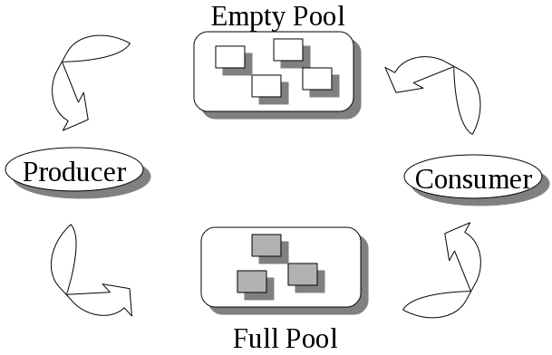
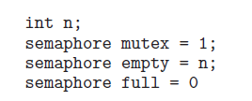
Classical Problems of Synchronization
The Bounded-Buffer problem
02

Slide 211
Classical Problems of Synchronization
The Bounded-Buffer problem
We assume that the pool consists of n buffers, each capable of holding one item.
The mutex semaphore provides mutual exclusion for accesses to the buffer pool and is initialized to the value 1.
The empty and full semaphores count the number of empty and full buffers.
The semaphore empty is initialized to the value n; the semaphore full is initialized to the value 0.
02

Slide 212
Classical Problems of Synchronization
The Bounded-Buffer problem
Producer process
do {
* // produce an item in nextp
….
wait(empty);
wait(mutex);
// add nextp to buffer signal(mutex);
signal(full);
}while (TRUE):
Consumer process
do {
wait(full);
wait(mutex);
// remove an item from buffer to nextc signal(mutex);
signal(empty);
// consume the item in nextc
} while (TRUE);
We can interpret this code as the producer producing full buffers for the consumer or as the consumer producing empty buffers for the producer.
02

Slide 213
Classical Problems of Synchronization
The Reader’s-Writer’s problem
Suppose that a database is to be shared among several concurrent processes.
Some of these processes may want only to read the database, whereas others may want to update (that is, to read and write) the database.
We distinguish between these two types of processes by referring to the former as readers and to the latter as writers.
If two readers access the shared data simultaneously, no adverse effects will result.
However, if a writer and some other process (either a reader or a writer) access the database simultaneously, chaos may ensue.
02

Slide 214
Classical Problems of Synchronization
The Reader’s-Writer’s problem
To ensure that these difficulties do not arise, we require that the writers have exclusive access to the shared database while writing to the database.
This synchronization problem is referred to as the readers–writer problem.
02

Slide 215
Classical Problems of Synchronization
The Reader’s-Writer’s problem
The reader–writers problem has several variations, all involving priorities.
The simplest one, referred to as the first readers–writers problem, requires that no reader be kept waiting unless a writer has already obtained permission to use the shared object.
In other words, no reader should wait for other readers to finish simply because a writer is waiting.
02

Slide 216
Classical Problems of Synchronization
The Reader’s-Writer’s problem
The second reader–writer’s problem requires that, once a writer is ready, that writer performs their writing as soon as possible. In other words, if a writer is waiting to access the object, no new readers may start reading.
02

Slide 217
Classical Problems of Synchronization
The Reader’s-Writer’s problem
Structure of Readers Process
do { *
wait(mutex);
readcount + + ;
if (readcount == 1)
wait(wrt);
signal(mutex);
// reading is performed
wait (mutex) ,-
readcount--;
if (readcount == 0)
signal(wrt);signal(mutex);
)while (TRUE);
Structure of Writers Process
do {
wait(wrt);
// writing is performed
signal (wrt) ,-
}while (TRUE);
02

Slide 218
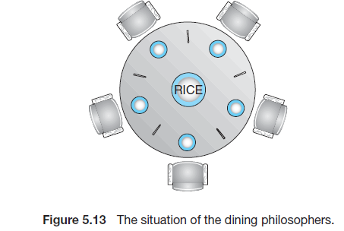
Classical Problems of Synchronization
The Dining-Philosophers Problem
Consider five philosophers who spend their lives thinking and eating.
The philosophers share a circular table surrounded by five chairs, each belonging to one philosopher.
In the center of the table is a bowl of rice, and the table is laid with five single chopsticks.
When a philosopher thinks, she does not interact with her colleagues.
From time to time, a philosopher gets hungry and tries to pick up the two chopsticks that are closest to her (the chopsticks that are between her and her left and right neighbors).
02

Slide 219
Classical Problems of Synchronization
The Dining-Philosophers Problem
A philosopher may pick up only one chopstick at a time.
She cannot pick up a chopstick that is already in the hand of a neighbor.
When a hungry philosopher has both her chopsticks at the same time, she eats without releasing the chopsticks.
When she is finished eating, she puts down both chopsticks and starts thinking again.
02

Slide 220
Classical Problems of Synchronization
The Dining-Philosophers Problem
The dining philosophers problem is considered a classic synchronization problem.
It is a simple representation of the need to allocate several resources among several processes in a deadlock-free and starvation-free manner.
02

Slide 221
Classical Problems of Synchronization
The Dining-Philosophers Problem
One simple solution is to represent each chopstick with a semaphore.
A philosopher tries to grab a chopstick by executing a wait() operation on that semaphore.
She releases her chopsticks by executing the signal() operation on the appropriate semaphores.
02

Slide 222
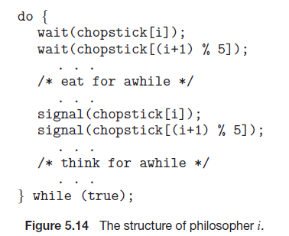
Classical Problems of Synchronization
The Dining-Philosophers Problem
semaphore chopstick[5];
02

Slide 223
Unit Summary
Unit 1:Introduction - Process Management
Introduction: Batch Systems, Multiprogramming and Time Sharing, Parallel, Distributed and Real-time Systems, Operating System Structures, Components & Services, System calls.
Process Management: Process Concept, Process Scheduling, Threads, Inter- process communication, CPU Scheduling Criteria, Scheduling algorithm, Multiple Processor Scheduling,. The Critical Section Problem, Synchronization hardware, Semaphores, and Classical problems of synchronization.
06

Slide 224

Thank You

